Slide 1


Drops of LTSpice
How to create functions

Slide 2
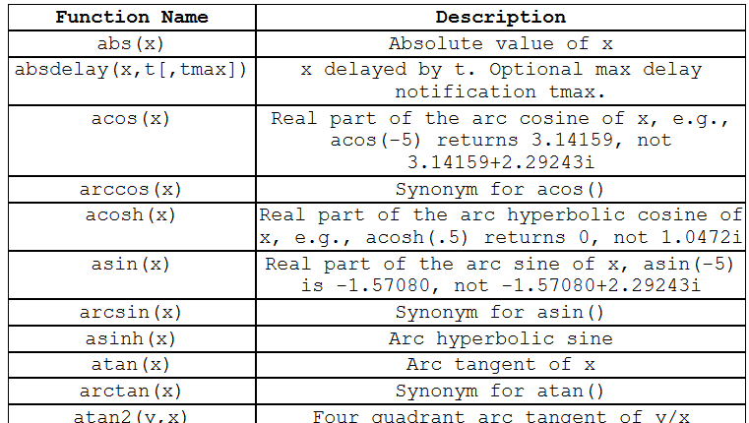
You already know that LTSpice has a set of really cool math functions.
But can we create our own functions?

Slide 3
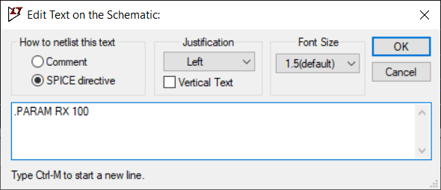
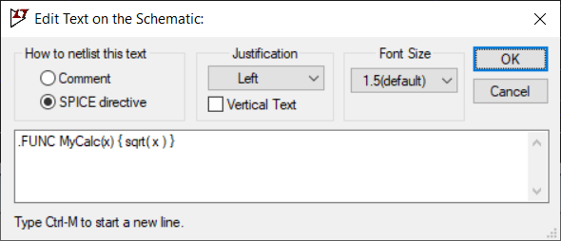
Yes, we can. And there are two ways.
For constant values, we can use the .param directive.
For variables such as time and voltage, we use the .func directive.

Slide 4
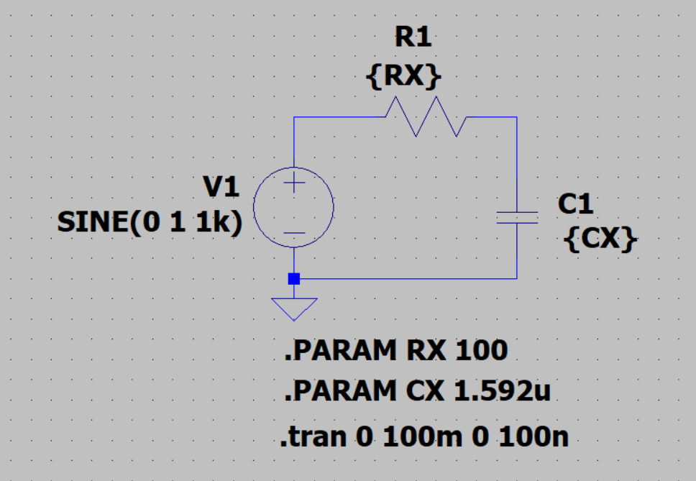
For example…
Let's imagine a circuit with a capacitor and resistor.

Slide 5
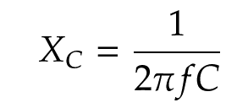
Let's imagine that we want the impedance of the capacitor to be the same as that of the resistor.
Once…
f=1kHz and R=100Ω
Xc=1.592μF
But it's more fun to have LTSpice calculate it for us.

Slide 6
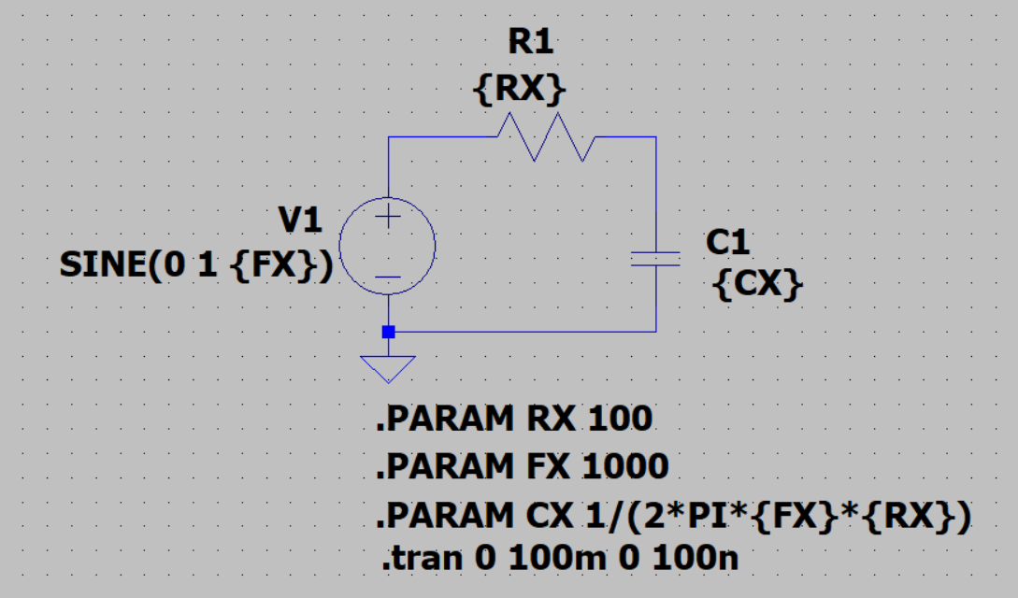
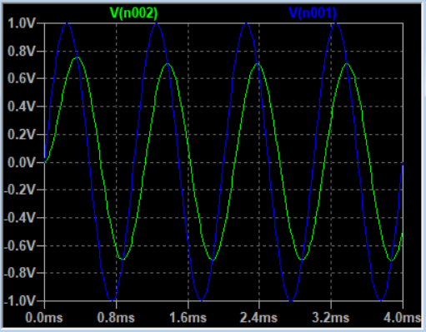
And we can use .param to do this for us.

Slide 7
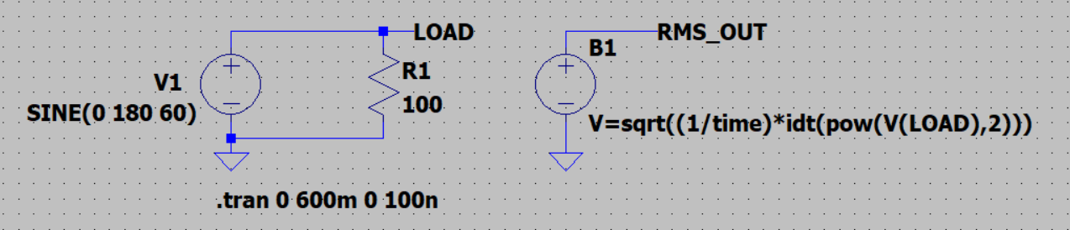
Now… let's now imagine a calculation using the voltage values generated in the simulation.
We can use an arbitrary voltage source to give us the resulting RMS voltage.
But it's a mess.

Slide 8
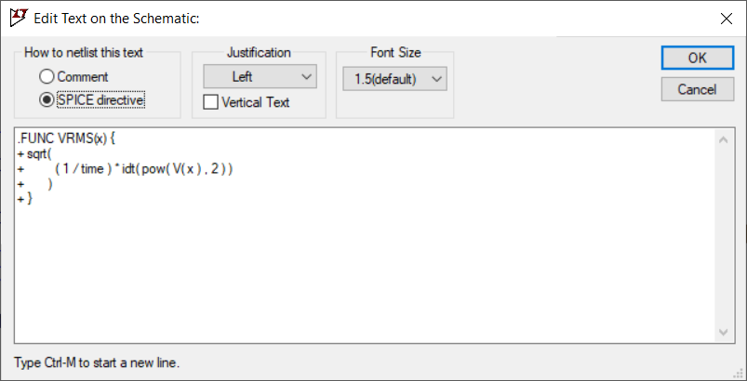
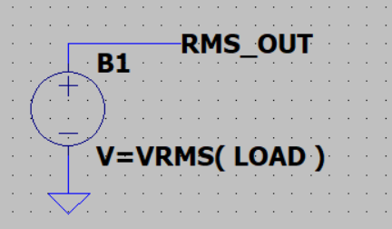
Editing a function is simpler.
And the result is cleaner.

Slide 9
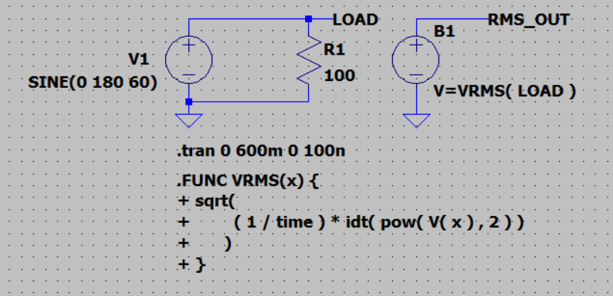
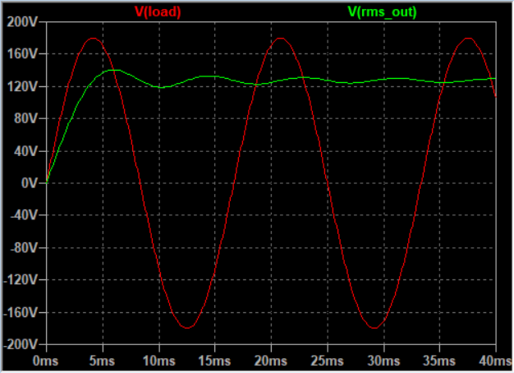
And the result is professional!
Francesco Sacco
linkedin.com/in/saccofrancesco

